Slide 1
On The Spot Delivery
Release 1.0 Presentation

Slide 2
Stakeholder Functionality
Complete Customer Functionality
Usable System that can generate revenue

Slide 3
User stories implemented in release one
Sprint One
Sprint Two
Story ID | Story Title | Story Points
SRCX35 | Company Home Page | 2
SRCX16 | Customer Account Creation | 4
SRCX36 | Customer Login Page | 2
SRCX17 | Customer Online Order Submission | 4
SRCX9 | Unique Identifier for Orders | 1
 | Story Point Sub-Total: | 15
Story ID | Story Title | MoSCoW | Story Points
SRCX31 | Secure Passwords | Must Have | 1
SRCX25 | Company Contact Information Page | Must Have | 2
SRCX37 | Company About Page | Should Have | 2
SRCX28 | Customer FAQ Page | Should Have | 2
SRCX95 | Date Time Picker on Customer Creation Screen | Must Have | 1
SRCX96 | Order confirmation upon order submission | Must Have | 1
SRCX97 | Driver Account Creation | Must Have | 4
SRCX39 | Driver Login Page | Must Have | 2
 |  |  | Story Point Sub-Total: 15

Slide 4
Time Estimates
Sprint One:
- Estimated (70 hours)
- Actual (107 hours)
Sprint Two:
- Estimated (117 hours)
- Actual (112 hours)

Slide 5
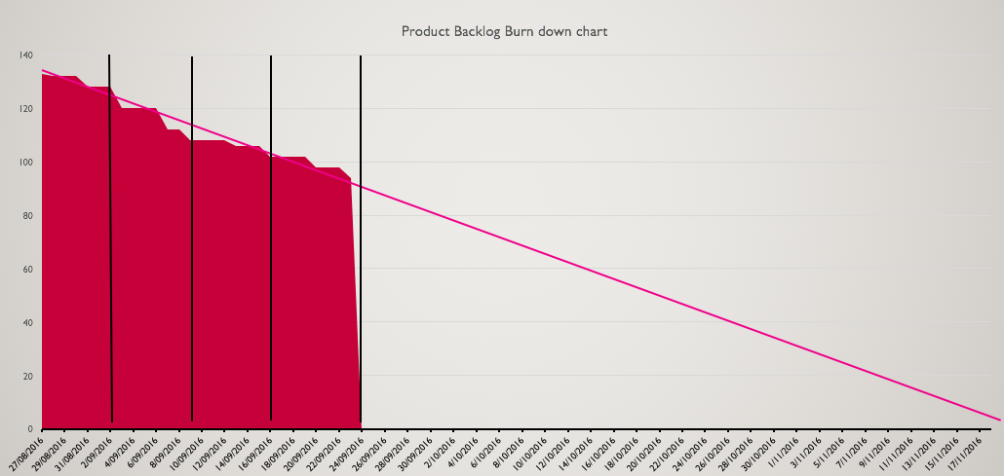
Burn down chart

Slide 6
Demonstration
http://onthespotdelivery.herokuapp.com

